Slide 1
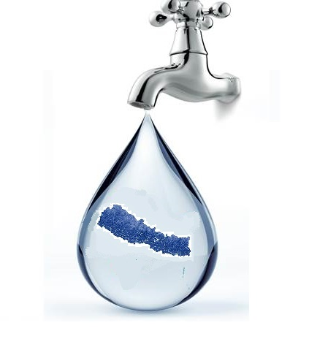

QUANTITY OF WATER
Source: sprin.org
Group Members:
Pradeep, 103
Pragyan, 104
Prajwal, 105
Prakash, 106
Pramod, 107
Pranish, 108
Tutor:
Asst.Prof. Shukra Raj Poudel
Department of
Civil Engineering
IOE, Tribhuvan University
Dec 26, 2019

Slide 2
Objectives of the Presentation
Students will be able to learn the following things:
Various types of water demand of the community
The factors affecting water demand
Estimation of water demand
Necessity of population forecasting and its methods

Slide 3
Presentation Outline
3.0 Introduction
3.1 Per capita demand of water
3.2 Base and design periods
3.3 Types of water demand
3.4 Variation in demand of water
3.5 Factors affecting demand of water
3.6 Peak factor
3.7 Population forecasting
3.8 Numerical on population forecasting and water demands

Slide 4
3.0 Introduction:
The first step in the design of water supply system of a community is the determination of the quantity of water required in the community for various purposes.
Quantity of water will determine the sizes and capacities of all the components of water supply system such as intake chamber, transmission main, water treatment units, reservoir, distribution system, etc.
Estimation of the quantity of water (or, water demand) requires the following three factors to be known:
Per capita demand of water or rate of demand
Base and design period
Population

Slide 5
3.1 Per capita demand of water
The average quantity of water consumption or water demand for various purposes per person per day is known as per capita demand or water.
It is usually expressed in liters per capita per day (lpcd).
The per capita demand of water may vary according to the lifestyle of people and the development of community. Water demand in l/d = Per capita demand x Population

Slide 6
3.2 Base and design periods
Base Period
It is the period required for the survey, design and construction of a water supply system.
Normally, It spans for 2 to 3 years of time for a water supply system.
Design Period
Generally water system projects are designed for a design period of 20 to 40 years.
Different segments of the water treatment and distribution systems may be approximately designed for differing periods of time using differing capacity criteria, so that expenditure far ahead of utility is avoided.

Slide 7
3.2.1 Typical Base and Design Periods
Generally adopted in Nepal:
Community | Base Period (Years) | Design Period (Years)
Rural water supply system with low population growth rate | 2-3 | 20
Rural water supply system with high population growth rate | 2-3 | 15
Urban water supply system | 2-3 | Up to 30
Water Supply Engineering
Prof. Dr. Bhagwan Ratna Kansakar

Slide 8
3.2.2 Selection Basis of Design Period
Population growth rate
Development of community
Useful life of component structures
Availability of funds
Rate of interest on borrowings
Availability of water at source

Slide 9
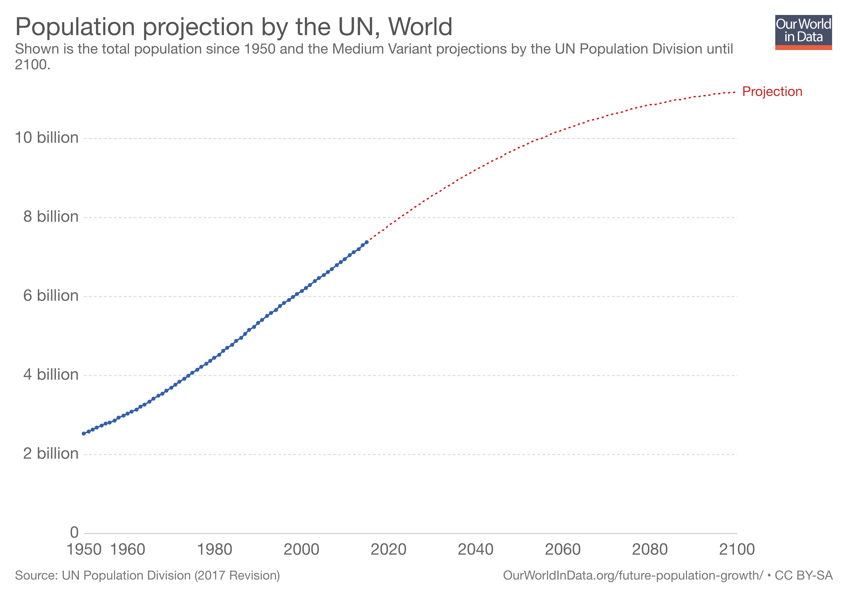
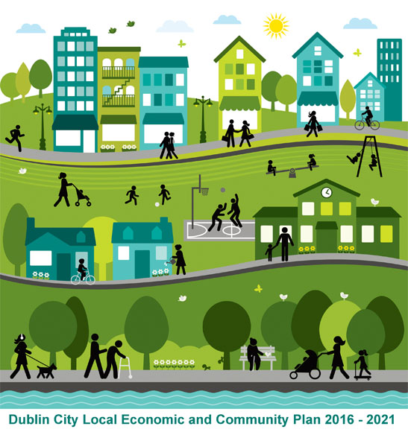
3.2.2 Selection Basis of Design Period
Continued…
Population Growth Rate Higher the population growth rate, shorter the adopted design period.
Development of Community If the community is rapidly developing there will be high population growth rate, so shorter design period is adopted.
wpmucdn.com
dublincity.ie

Slide 10
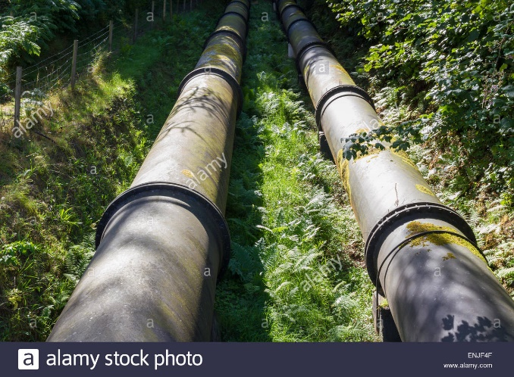
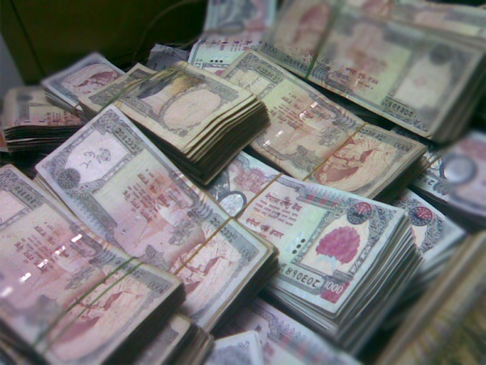
3.2.2 Selection Basis of Design Period
Continued…
Useful Life of Component Structures The useful life of the component structures depends on the quality and type of materials. The design period should not exceed this time period.
Availability of Funds When limited funds are available shorter, design period is adopted, and vice-versa.
nepalmount-wordpress.com

Slide 11

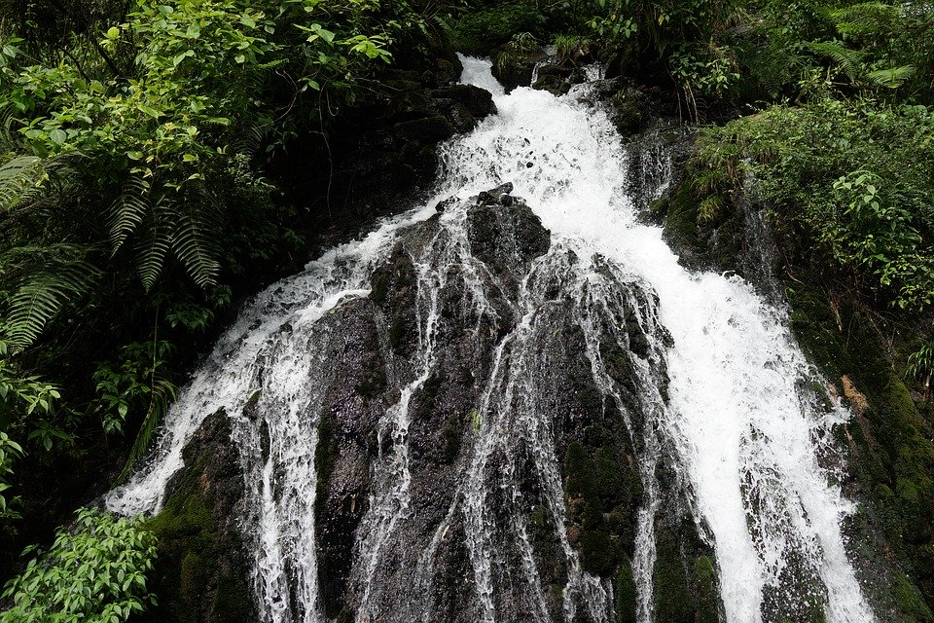
3.2.2 Selection Basis of Design Period
Continued…
Rate of Interest on Borrowings Lower the interest rate, longer the design period can be made.
Availability of Water at Source Shorter design period is adopted if the water available at the source is limited, and vice-versa
pixabay.com

Slide 12
3.2.3 Base and Design Years
Base Year
It is the year in which water is delivered to the community by a water supply system after the completion of its construction.
Base year = Survey year + Base period where, Base period is usually 2 - 3 years.
Survey Year
+ Base Period
Base Year
+ Design Period
Design Year
Design Year
It is the year upto for which a water supply system is designed.
The sizes and components of all water supply system components are calculated for the design year.
Design year = Base Year + Design Period

Slide 13
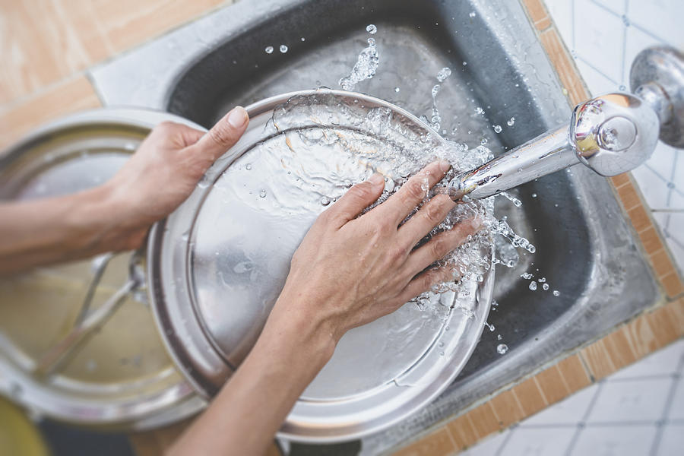
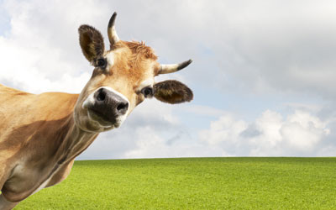
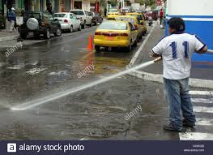
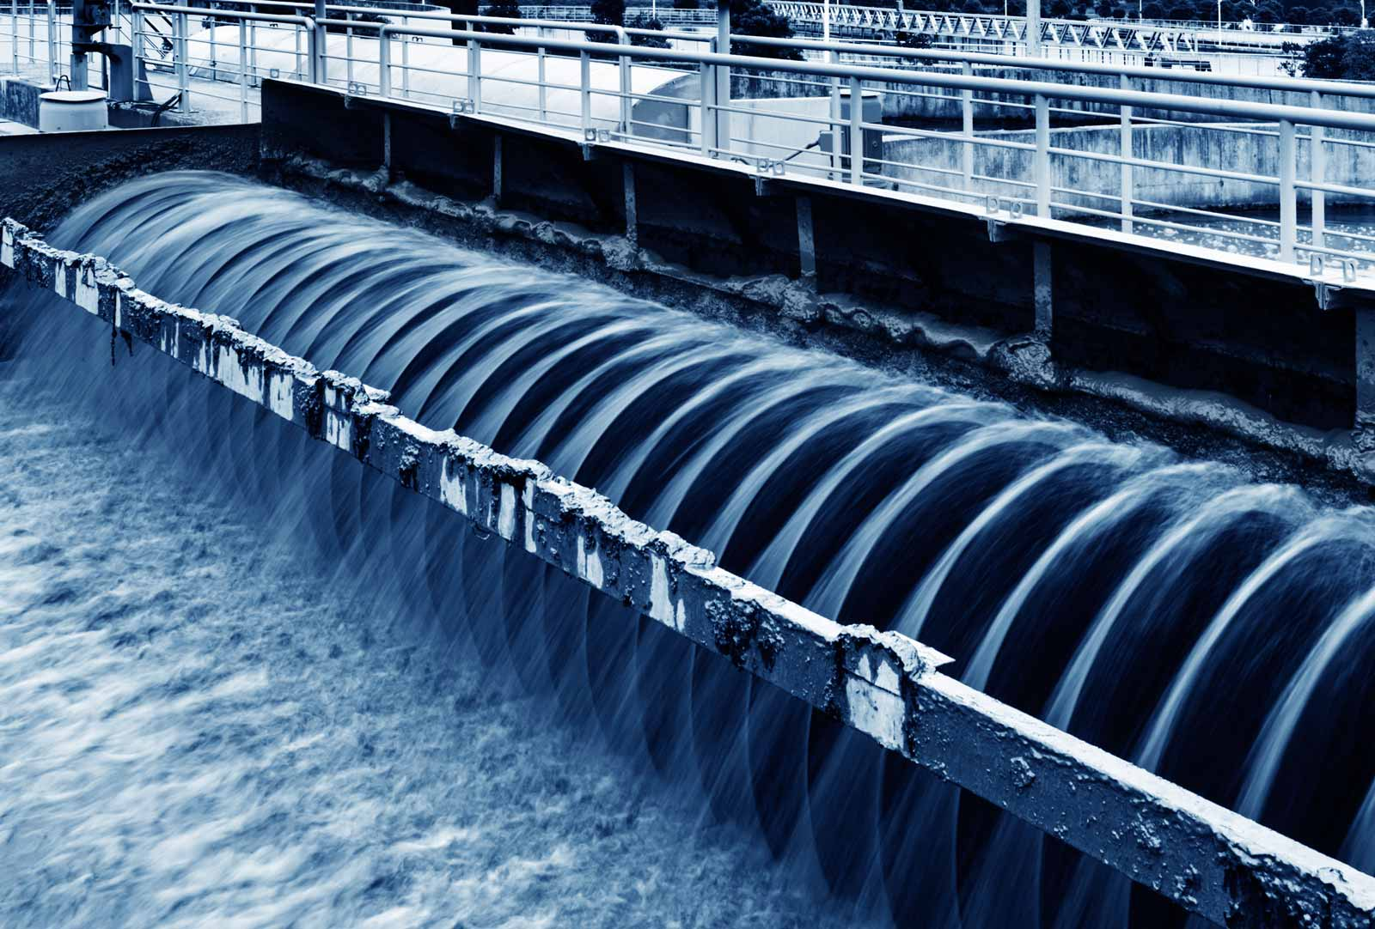
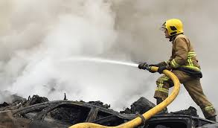
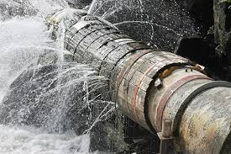
3.3 Types of Demand
3.3.1 Domestic Demand
3.3.2 Livestock Demand
3.3.3 Commercial Demand
3.3.4 Public/Municipal Demand
3.3.5 Industrial Demand
3.3.6 Fire Demand
3.3.7 Loss and Wastage
3.3.8 Total Water Demand
www.alamy.com
Engineeringnotes.com
alamy.com
Indiamart.com
dreamstime.com
archive.swmm.info

Slide 14
3.3.1 Domestic Demand
It includes the water which is required for use in a private residence, apartment, houses for drinking, cooking, sanitary purpose, etc..
This demand depends on the living standard of people.
The domestic water demand in Nepal is generally taken as follows:-
Type of house | Requirement (lpcd)
Fully plumbed house | 112lpcd
Partly plumbed house | 65lpcd
Rural area served by public stand post | 45lpcd
Water Supply Engineering
Prof. Dr. Bhagwan Ratna Kansakar

Slide 15
3.3.2 Livestock Demand
It includes the water consumed by domesticated animals like horses, cows, pigs, etc.
The quantity of water depends upon the type and size of animals.
Livestock demands in Nepal are generally taken as follows:
Animals | lpcd (liters/animal/day)
Cows, buffalo, horse | 45 lpcd
Pigs, Sheep, Goats, | 20 lpcd
Chickens, ducks | .2
Water Supply Engineering
Prof. Dr. Bhagwan Ratna Kansakar

Slide 16
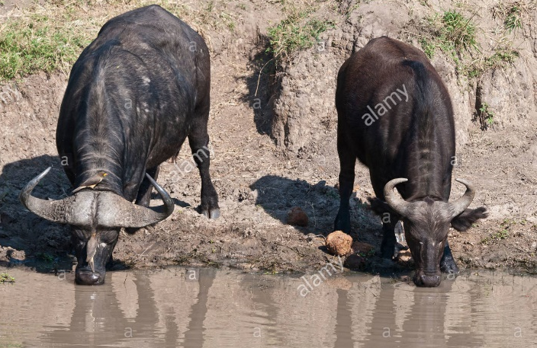
3.3.2 Livestock Demand
Continued…
Livestock demand will not solely depend on the water supply system. Many Livestock's will utilize natural rivers, streams, and ponds for the water during the grazing. Thus, livestock demand should not be more than 20% of domestic demand. So, in the rural area, this factor must be included and in the urban area, it can be neglected.
www.alamy.com

Slide 17
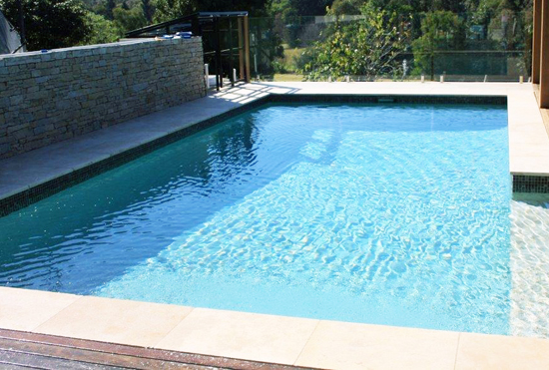
3.3.3 Commercial Demand
This includes the water demand for commercial establishments such as educational institutions, offices, hotels, hospitals, restaurants, etc.
The quantity depends on the type of commercial establishment. It must be taken into account.
mountainwater.com.au

Slide 18
3.3.3 Commercial Demand
Continued…
S.N. | Commercial Establishment | Water Demand
1 | Day-scholars in educational institutions | 10 liters/pupil/day
2 | Boarders in educational institutions | 65 liters/pupil/day
3 | Offices(depending upon size) | 500-100 liters/day
4 | Hospitals with bed | 500 liters/bed/day
5 | Hospitals without bed and health clinics | 2500 liters/day
6 | Hotels with bed | 200 liters/bed/day
7 | Hotels without bed | 500-100 liters/day
8 | Restaurants and tea stalls | 500-1000liters/day

Slide 19
3.3.4 Public/Municipal Demand
This includes the quantity of water required for public or municipal utility purposes such as watering of public parks, sanitary purposes (road washing,..).
A provision of 5 to 10% of the total consumption is made for these demands.
This demand is taken into account only in the urban community only.

Slide 20
3.3.5 Industrial Demand
This includes water for industrial purposes.
The presence of industries shows a greater impact on water demand.
For a city with moderate factories, a provision of 20 to 25 percent of total consumption may be made for the purpose only in urban.

Slide 21
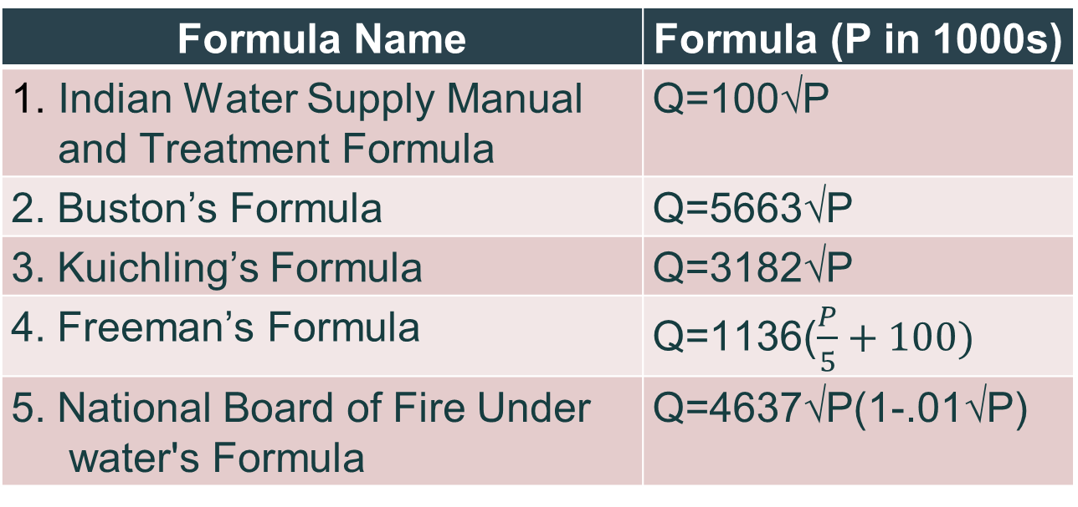
3.3.6 Fire demand
It is the quantity of water required for fire fighting purposes.
In a thickly populated area, fire may break out and may result in severe damages.
Various schemes for fire demand estimation are:
Formula Name | Formula (P in 1000s)
Indian Water Supply Manual and Treatment Formula | Q=100√P
2. Buston’s Formula | Q=5663√P
3. Kuichling’s Formula | Q=3182√P
4. Freeman’s Formula | Q=1136($\frac{P}{5}+100)$
5. National Board of Fire Under water's Formula | Q=4637√P(1-.01√P)

Slide 22
3.3.7 Loss and Wastage
This includes the losses of water due to leakage in main veins, valves, and other fitting, worn or damaged meters, theft of water and other reasons.
In the case of well maintained and fully metered water distribution system, the losses hardly exceed 15% of the total supply.
And in the system where there is a weak management system, there may be a loss of water up to 50 % of the total supply.
archive.swmm.info

Slide 23
3.3.8 Total Water Demand
TWD
=DD + LD + CD + PD + ID + FD+ LW
Where,
TWD = Total Water Demand
DD = Domestic demand
LD = Livestock Demand
CD = Commercial Demand
PD = Public/municipal Demand
ID = Industrial Demand
FD = Fire Demand
LW = Loss and Wastage

Slide 24
3.4 Variation in Water Demands and Parameters
S.N. | Variation | Peak Factor | Time of maximum demand | Uses
1. | Seasonal | 1 | High in summer Low in winter | Drinking, cooking, fire breakout
2. | Daily | 1.1 | Holiday, Saturday, festivals | Washing, bathing
3. | Hourly | 3 | Morning: 5 to 7 am Evening: 5 to 7 pm | Cleaning, cooking, bathing

Slide 25
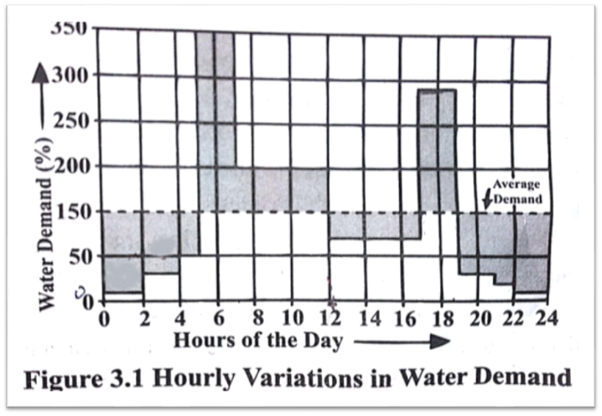
3.4 Variation in Water Demands and Parameters
Continued…
Hourly Variations in Water Demand
Water Supply Engineering
Prof. Dr. Bhagwan Ratna Kansakar

Slide 26
3.5 Factors Affecting Demand of Water
Climatic condition:
Requirement is more at places having hot and dry climate than at places having cold and humid climate. More water is consumed during summer. In extremely cold climates, water may be wasted due to taps being always kept open to avoid freezing of pipes, which may result in increased rate of consumption
Cost of water:
The rate at which water is supplied to the public affects the demand of it. If the rates at which water is supplied are high, lesser quantity of water may be consumed by the people, and vice versa.

Slide 27
3.5 Factors Affecting Demand of Water
Quality of Water:
Water consumption will be more if quality of water supplied is good because consumers will feel safe to use water and use it liberally. Poor quality of water results in the reduction of the water use.
System of Supply:
The rate of demand is less in the intermittent system of supply because only limited water is supplied in this system and consumers are forced to use limited amount of water.

Slide 28
3.5 Factors Affecting Demand of Water
Pressure in Distribution System
At high distribution pressure, there is increase in loss and waste of water.
Method of Charging- Metered or Unmetered:
Metered water supply system means that meters are fitted at the head of individual household connections, which record the quantity of water consumed. As with metered system, consumers become more conscious about the usage to reduce the water bills whereas in unmetered households, consumers use water more liberally and water demand increases significantly.

Slide 29
3.5 Factors Affecting Demand of Water
Continued…
Standard of Living:
The higher the standards of living, greater will be the demand of water because people can afford the luxury and use more water.
Sewerage System:
A town with good sewerage system has high demand of water. More water is consumed for flushing sanitary units such as urinals, water closets, etc.

Slide 30
3.6 Peak Factor
It is the ratio of maximum or peak demand of water to that of the average annual demand for water.
Max demand or peak demand = peak factor * annual average demand
Or, Peak factor = seasonal peak factor * daily peak factor * hourly peak factor
The peak factor of 2 to 4 is adopted in Nepal for a continuous system of supply.

Slide 31
3.7 Population Forecasting
Population of an area keeps changing and generally it increases with time.
It is necessary to estimate future population for the end of service.
The information of population of city or village of nepal can be obtained from census data
Various methods are available for population forecasting and designers should choose the suitable methods among them.

Slide 32
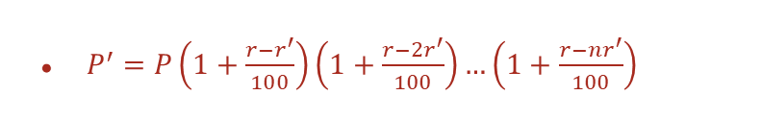


Methods of Population Forecasting:
01
Arithmetic Increase Method
P’=P+I*n
02
Geometric Increase Method
$$P^{′}=P(1+\frac{r}{100})$$
03
Incremental Increase Method
$$P^{′}=P+n∗I+\frac{n(n+1)}{2}∗x$$
Methods of Population Forecasting
04
Decreasing Rate Method
$P^{′}=P\left(1+\frac{r−r^{′}}{100}\right)\left(1+\frac{r−2r^{′}}{100}\right)…\left(1+\frac{r−nr^{′}}{100}\right)$
05
Simple Graphical Method
Simple graph is used
06
Comparative Graphical Method
Population of different cities is used
08
Master Plan Method
Cities are divided into small parts

Slide 33
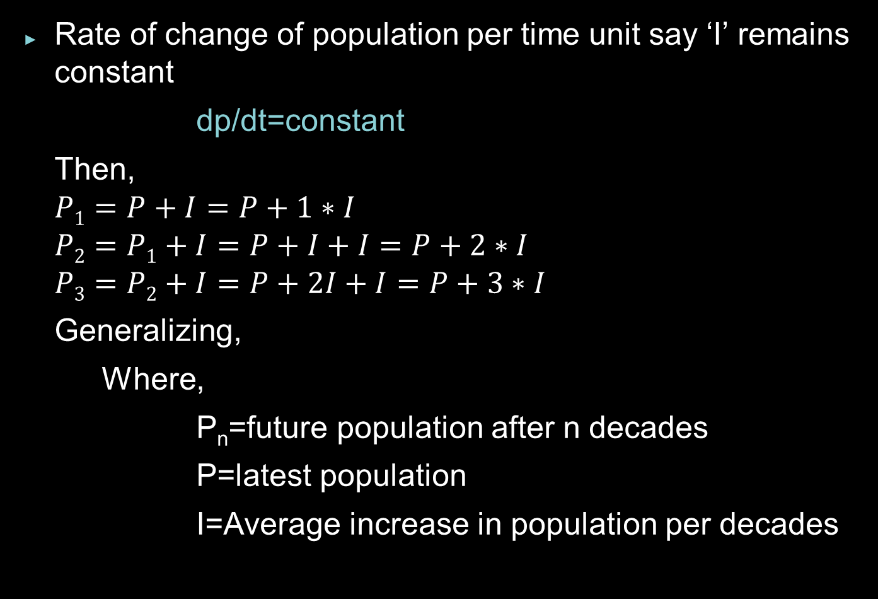

01. Arithmetic Increase Method
Rate of change of population per time unit say ‘I’ remains constant
dp/dt=constant
Then,
$$P1=P+I=P+1∗I$$
$$P2=P1+I=P+I+I=P+2∗I$$
$$P3=P2+I=P+2I+I=P+3∗I$$
Generalizing,
Where,
P_{n}=future population after n decades
P=latest population
I=Average increase in population per decades
$$Pn=P+n∗I$$

Slide 34


02. Geometric Increase Method
Percentage increase in population per decade is assumed to be constant
Future population is given by:
$Pn=P(1+\frac{r}{100})(1+\frac{r}{100})…..($1+$\frac{r}{100})$
Where,
P_{n}=future population after n decades
r= average percent increase in population
P=latest population
}
}
$$P^{′}={P(1+\frac{r}{100})}^{n}$$
After one decade
After two decades

Slide 35
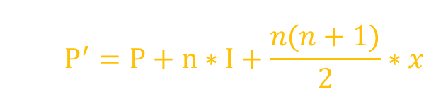
03. Incremental Increase Method
Improvement over Arithmetic and Geometric Method seems to be combination of them
The increment in increase in population is called incremental increase
It may be positive and negative
Future population is given by:
Where,
P_{n} = Future population after n decades
P = latest population
I = Average increase in population per decade
x = Average Incremental increase in population per decade
$$P^{′}=P+n∗I+\frac{n(n+1)}{2}∗x$$

Slide 36

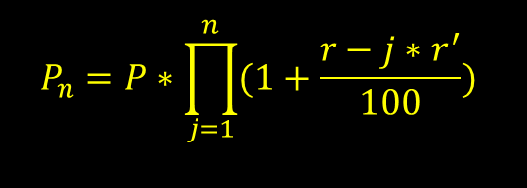
04. Decreasing Rate of Growth or
Changing Rate of Growth Method
Rate of change of increase in population is assumed to be constant
dr/dt=constant
Then,
$P1=P(1+\frac{r−r′}{100})$
$P2=P1(1+\frac{r−2r^{′}}{100})=P(1+\frac{r−r^{′}}{100})(1+\frac{r−2r′}{100})$
Generalizing
$$P_{n}=P∗\prod_{j=1}^{n}{(1+\frac{r−j∗r^{′}}{100})}$$

Slide 37
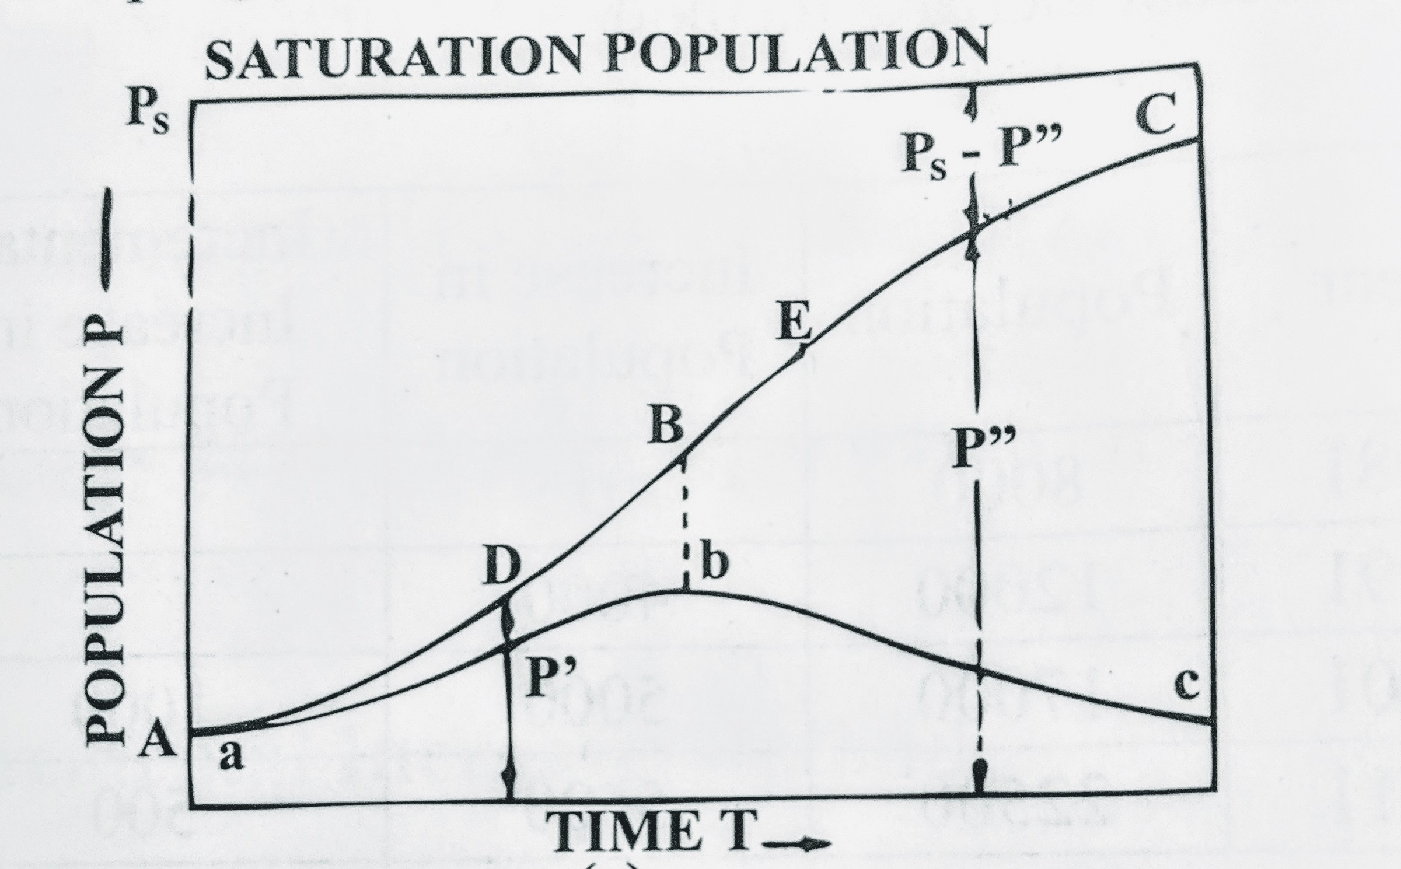
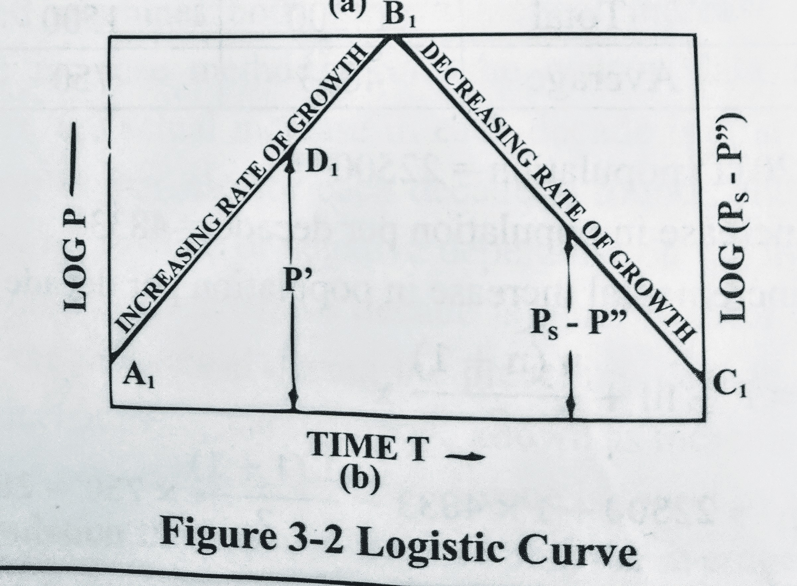
Continued...
Where,
Pn= Future population after n decade
P = Latest population
r = Percentage increase in population of last decade
r’ = Average decrease in rate of increase in population per decade

Slide 38
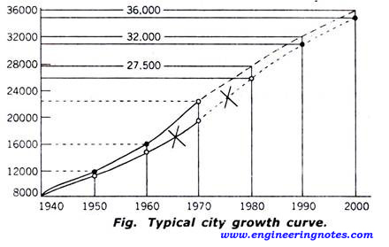
05. Simple Graphical Method

Slide 39
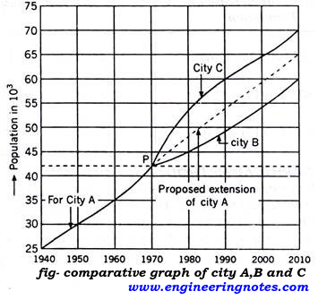
06. Comparative Graphical Method

Slide 40
07. Master Plan Method
The big and metropolitan cities are generally not developed in haphazard manner, but are planned and regulated aby local bodies according to master plan.
The master plan is prepared for next 25 to 30 years for the city.
According to the master plan, ,the city is divided into various zones such as residence, commerce and industry.
The population densities are fixed for various zones.
By this method it is very easy to access precisely the design population.

Slide 41
3.8 Numerical Example of Population Forecasting:
Determine the population of the town in the year 2088 and 2084 by
a) Arithmetical Increase Method
b) Geometrical Increase Method
c) Incremental Increase Method
d) Decreased rate of Growth Method
The census population of the city is given as follows:
IOE 2072 Kartik
Year | 2068 | 2058 | 2048 | 2038 | 2028
Population | 65,500 | 57,000 | 47,000 | 37,000 | 29,000

Slide 42
Solution:
Year | Population | Increase in Population (per decade) | Incremental Increase | % Increase in Population | Decrease in % Increase In Population
2028 | 29,000 | - | - | - | -
2038 | 37,000 | 8,000 | - | 27.586 | -
2048 | 47,000 | 10,000 | 2,000 | 27.027 | 0.559
2058 | 57,000 | 10,000 | 0 | 21.277 | 5.75
2068 | 65,500 | 8,500 | -1,500 | 14.912 | 6.365
Total: |  | 36,500 | 500 | 90.802 | 12.674
Average: |  | 9125 | 166.667 | 22.701 | 4.225
29,000
37,000
8,000
10,000
-
=
8,000
2,000
Notes:
Am-I value, GM– percentage increase, Incremental method– x and decrease rate of growth ko lage r dash last column

Slide 43
Solution:
Year | Population | Increase in Population | Incremental Increase | % Increase in Population | Decrease in % Increase In Population
2028 | 29,000 | - | - | - | -
2038 | 37,000 | 8,000 | - | 27.586 | -
2048 | 47,000 | 10,000 | 2,000 | 27.027 | 0.559
2058 | 57,000 | 10,000 | 0 | 21.277 | 5.75
2068 | 65,500 | 8,500 | -1,500 | 14.912 | 6.365
Total: |  | 36,500 | 500 | 90.802 | 12.674
Average: |  | 9125 | 166.667 | 22.701 | 4.225
29,000
8,000
27.586
27.027
-
/
*100%
=
0.559
27.586

Slide 44
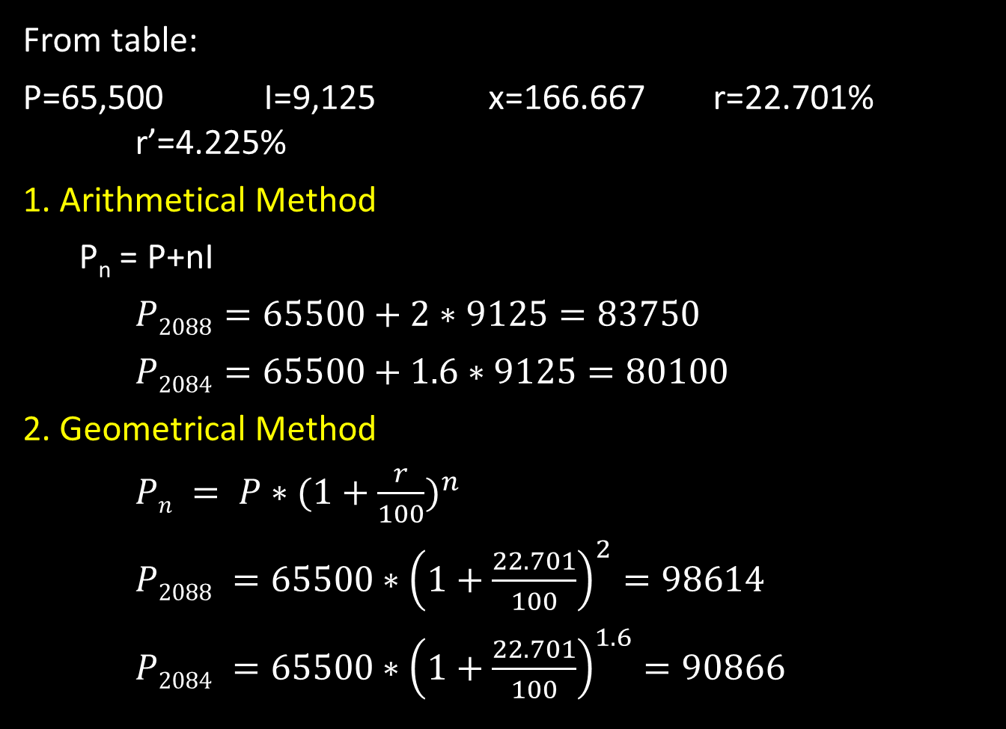
Continued…
From table:
P=65,500 I=9,125 x=166.667 r=22.701% r’=4.225%
1. Arithmetical Method
P_{n} = P+nI
$P2088=65500+2∗9125=83750$
$P2084=65500+1.6∗9125=80100$
2. Geometrical Method
$Pn = P∗{(1+\frac{r}{100})}^{n}$
$P2088 =65500∗{\left(1+\frac{22.701}{100}\right)}^{2}=98614$
$P2084 =65500∗{\left(1+\frac{22.701}{100}\right)}^{1.6}=90866$

Slide 45
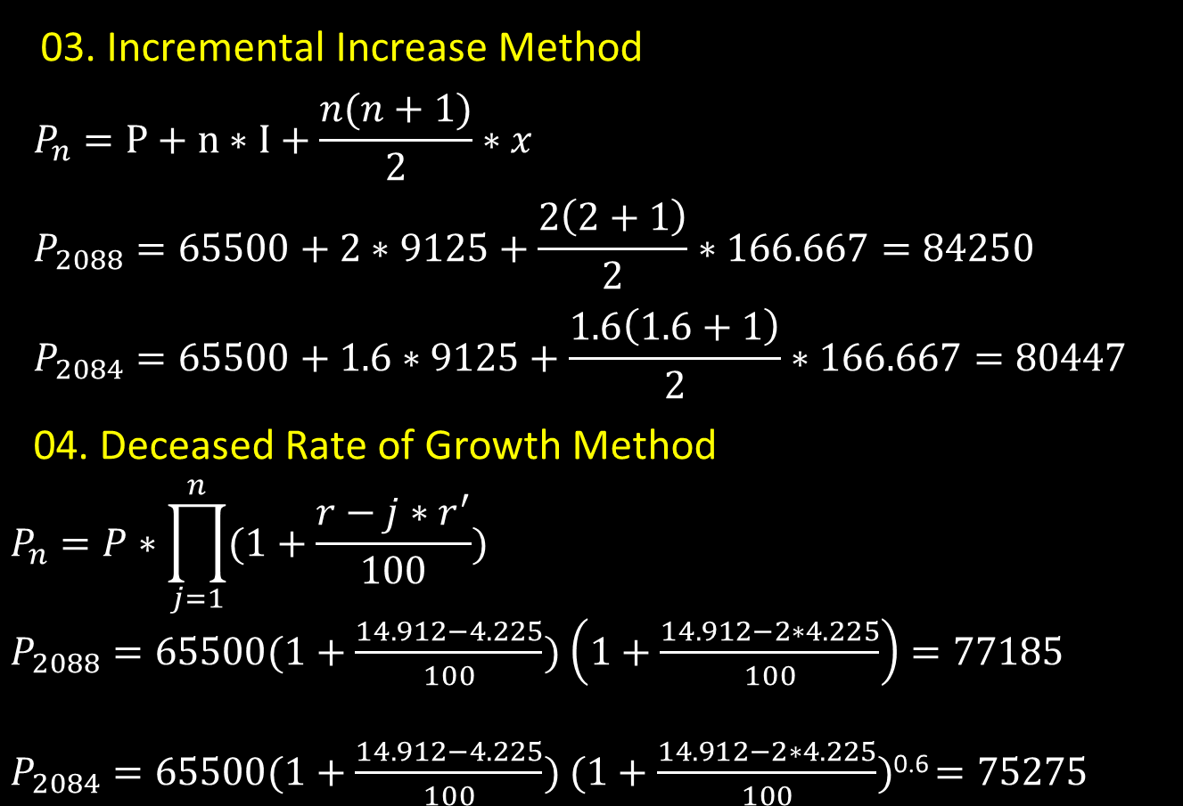
Continued…
03. Incremental Increase Method
$$P_{n}=P+n∗I+\frac{n(n+1)}{2}∗x$$
$$P_{2088}=65500+2∗9125+\frac{2\left(2+1\right)}{2}∗166.667=84250$$
$$P_{2084}=65500+1.6∗9125+\frac{1.6\left(1.6+1\right)}{2}∗166.667=80447$$
04. Deceased Rate of Growth Method
$$P_{n}=P∗\prod_{j=1}^{n}{(1+\frac{r−j∗r^{′}}{100})}$$
$P_{2088}=65500(1+\frac{14.912−4.225}{100})$ $\left(1+\frac{14.912−2∗4.225}{100}\right)=77185$
$P_{2084}=65500(1+\frac{14.912−4.225}{100})$ $(1+\frac{14.912−2∗4.225}{100})$^{0.6} $=75275$

Slide 46
Numerical Problem on Population on Population forecasting and water Demand
Data obtained from a baseline survey of newly formed municipality in year 2016 AD are as follows:
Survey year | 2013 | Annual Growth Rate | 1.5%
Base period | 3 years | Day Scholar Student | 100
Design period | 25 years | Boarder scholar students | 10
Population | 1250 | No. of Health Post | 1
Cows | 200 | No. of Tea Shop | 1
Goats | 500 | No. of VDC Office | 1
Chicken | 5000
Calculate average water demand for design year. IOE 2073 Chaitra

Slide 47
Solution:
Here,
Survey year = 2013
Base period = 3 years
Design period = 25 years
Total Design period = base period + design period
= 3 +25 = 28 years
Survey year population (P) = 1250
Survey year Day scholar students No. = 100
Survey year Boarder students No. = 10
Growth rate per year ( r ) = 1.5%

Slide 48
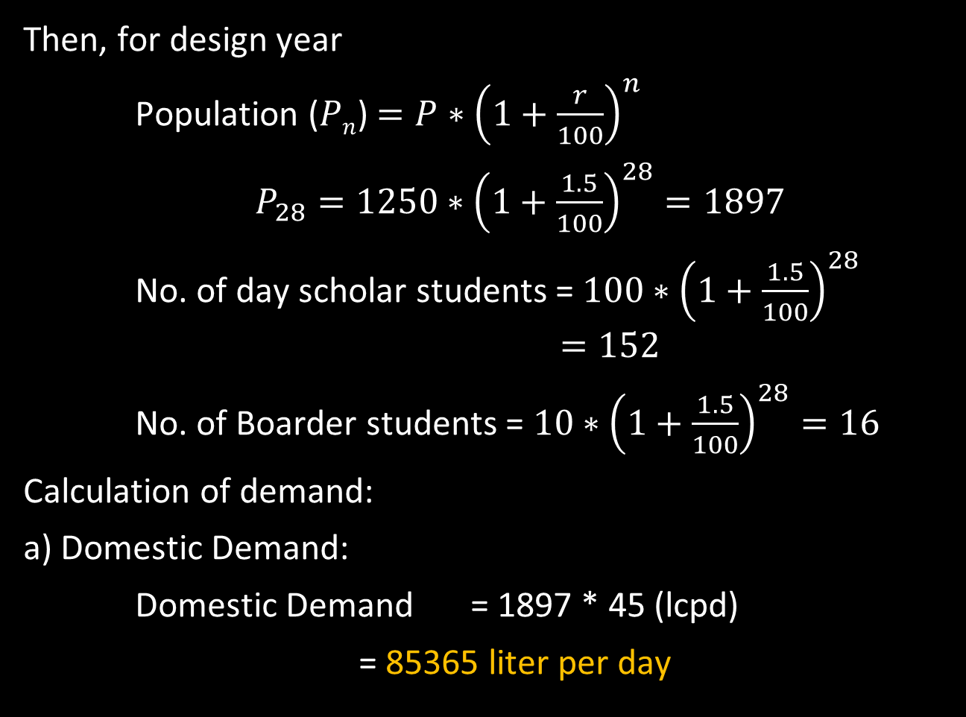
Continued…
Then, for design year
Population ($Pn$) $=P∗{\left(1+\frac{r}{100}\right)}^{n}$
$P_{28}=1250∗{\left(1+\frac{1.5}{100}\right)}^{28}=1897$
No. of day scholar students =$100∗{\left(1+\frac{1.5}{100}\right)}^{28}$ $=152$
No. of Boarder students = $10∗{\left(1+\frac{1.5}{100}\right)}^{28}=16$
Calculation of demand:
a) Domestic Demand:
Domestic Demand = 1897 * 45 (lcpd)
= 85365 liter per day

Slide 49
Continued…
b) Livestock Demand:
Cows= 200 * 45 (lpapd) = 9000 lit per day
Goats= 500 * 20 (lpapd) = 10000 lit per day
Chicken= 5000 *0.2(lpapd) = 1000 lit per day
Total = 20000 lit per day
20% of Domestic demand = 85365 * 20/100
= 17073 lit per day
Here, Livestock demand > 20% of Domestic demand
So, We have to take livestock demand = 20% of DD
=17073 lit per day
c) Institutional Demand or Commercial:
Day scholar student= 152 * 10 (lcpd)=1520 lit per day
Boarder students= 16 * 65 (lcpd)=1040 lit per day

Slide 50
Continued…
Health post = 1 * 2500 (lpd) = 2500 lit per day
Tea shop = 1 *1000 (lpd) = 1000 lit per day
VDC office = 1*1000 (lpd) = 1000 lit per day
Total Commercial Demand = 7060 lit per day
Hence, total Demand of water for design year is
=Domestic demand+Livestock demand+Commercial demand
= 85365 + 17073 + 7060
= 109498 lit per day

Slide 51
Thank you!

